Slide 1






AuctionNest
America’s Auction House
TEAM 7
TRI-ALLIANCE
SAMEER SHAIK
VIVEK KOMMAREDDY
PRAKHYA CHOWDARY

Slide 2



Agenda
KEY POINTS
Safe Online Auctions Emphasis on secure buying and selling. User Verification: Strict identity checks and profile validation. Secure Payments: Encrypted transactions with multiple payment methods. Trusted Community: Building a fraud-free, transparent marketplace.

Slide 3
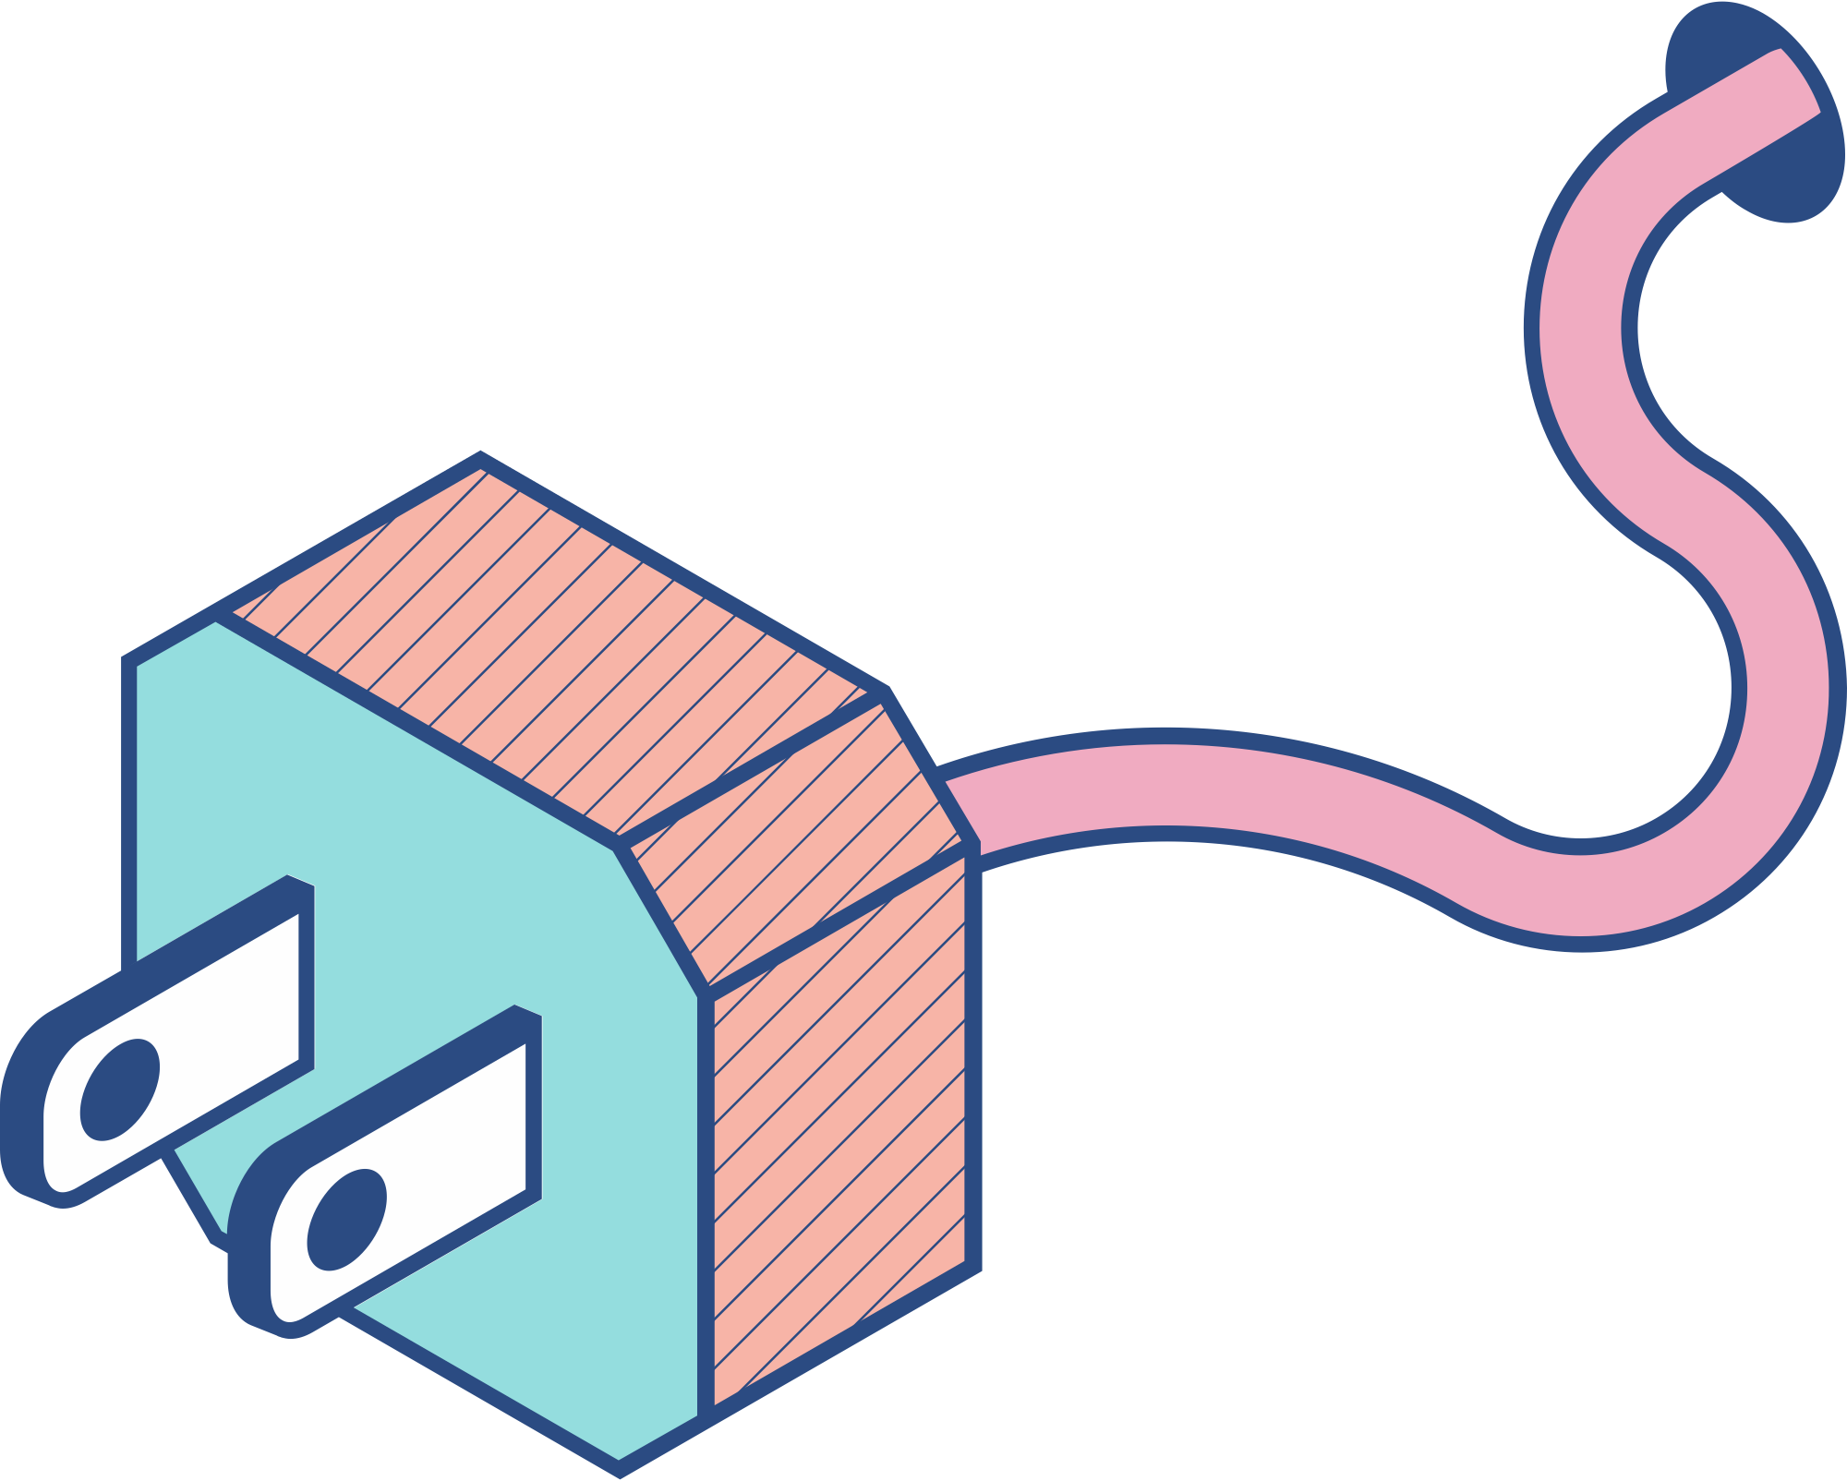
summary
Auctionnest is a cutting-edge online auction platform designed to provide a safe and secure environment for buying and selling, similar to Facebook Marketplace but with an added emphasis on security. Our platform offers users the opportunity to participate in auctions, whether they are buying or selling items, with the assurance that all transactions and interactions are safeguarded through our advanced verification processes.
At Auctionnest, we prioritize user safety by implementing strict measures to ensure that every user is verified. This verification process includes identity checks, profile validation, and transaction monitoring to ensure that all participants are genuine. Unlike many other auction platforms, we take these extra steps to create a trusted and secure marketplace. Buyers and sellers can engage in transactions with peace of mind, knowing that the person they are dealing with has been thoroughly vetted.

Slide 4

IIP
In addition to user verification, Auctionnest provides secure payment options. We have integrated robust payment gateways that protect financial information and ensure that payments are processed safely and efficiently. Our payment system supports multiple methods, giving users flexibility while also maintaining a high level of security. Transactions on Auctionnest are encrypted, and we use industry-standard security protocols to prevent fraud or unauthorized access to sensitive data.
What truly sets Auctionnest apart is our focus on building a trustworthy community of buyers and sellers. By ensuring that all users go through a verification process and by offering secure payment options, we significantly reduce the risks often associated with online auctions and marketplaces. We want to foster a positive, transparent, and secure environment where users can confidently bid on or list items without worrying about scams or fraud.
Whether you're looking to sell rare collectibles, purchase second-hand electronics, or find unique items at a bargain, Auctionnest provides a seamless experience that combines the convenience of online auctions with the highest levels of security. Our platform is user-friendly, and we've designed it to make the buying and selling process as easy and secure as possible for everyone. Join Auctionnest today and discover a safer way to auction!

Slide 5
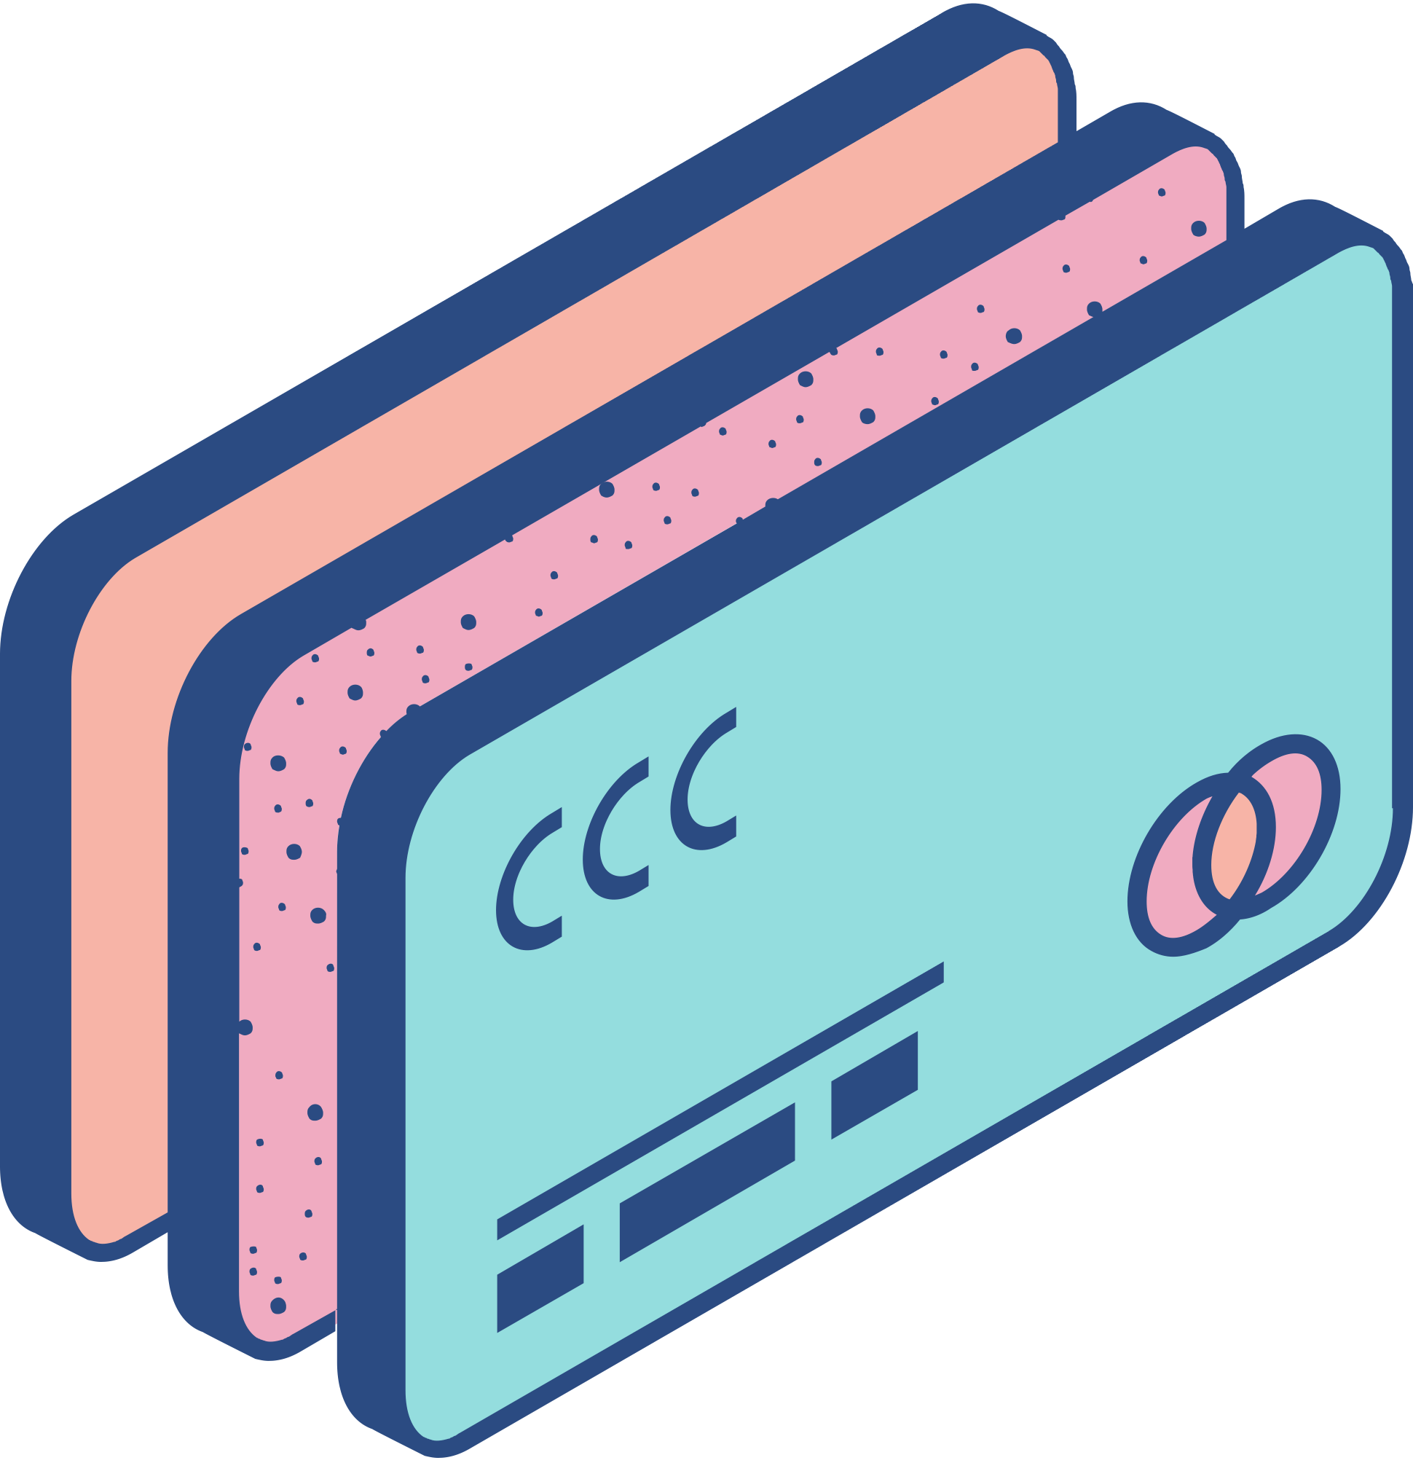
Organizations
that will use this system
Retailers & Art Auction Houses Best Buy & Sotheby’s | Non-Profit Organizations The Red Cross | Automotive Dealerships & CarMax & Dell
Best Buy can use Auctionnest to securely auction clearance electronics, offering buyers confidence through verified transactions. Similarly, Sotheby’s can auction valuable art pieces, ensuring that both buyers and sellers are vetted, making high-value transactions safer. | Non-profits like The Red Cross can host charity auctions on Auctionnest, raising funds for important causes while ensuring all participants are verified, and payments are secure, creating trust among donors and participants. Non-Profit Organizations The Red Cross | Automotive Dealerships & Tech CompaniesCarMax & Dell, CarMax could auction used vehicles with the confidence that all bidders are genuine, while Dell can use Auctionnest to sell refurbished tech products, guaranteeing secure payments and reducing the risk of fraud

Slide 6

Two systems in this space and their reviews

Slide 7
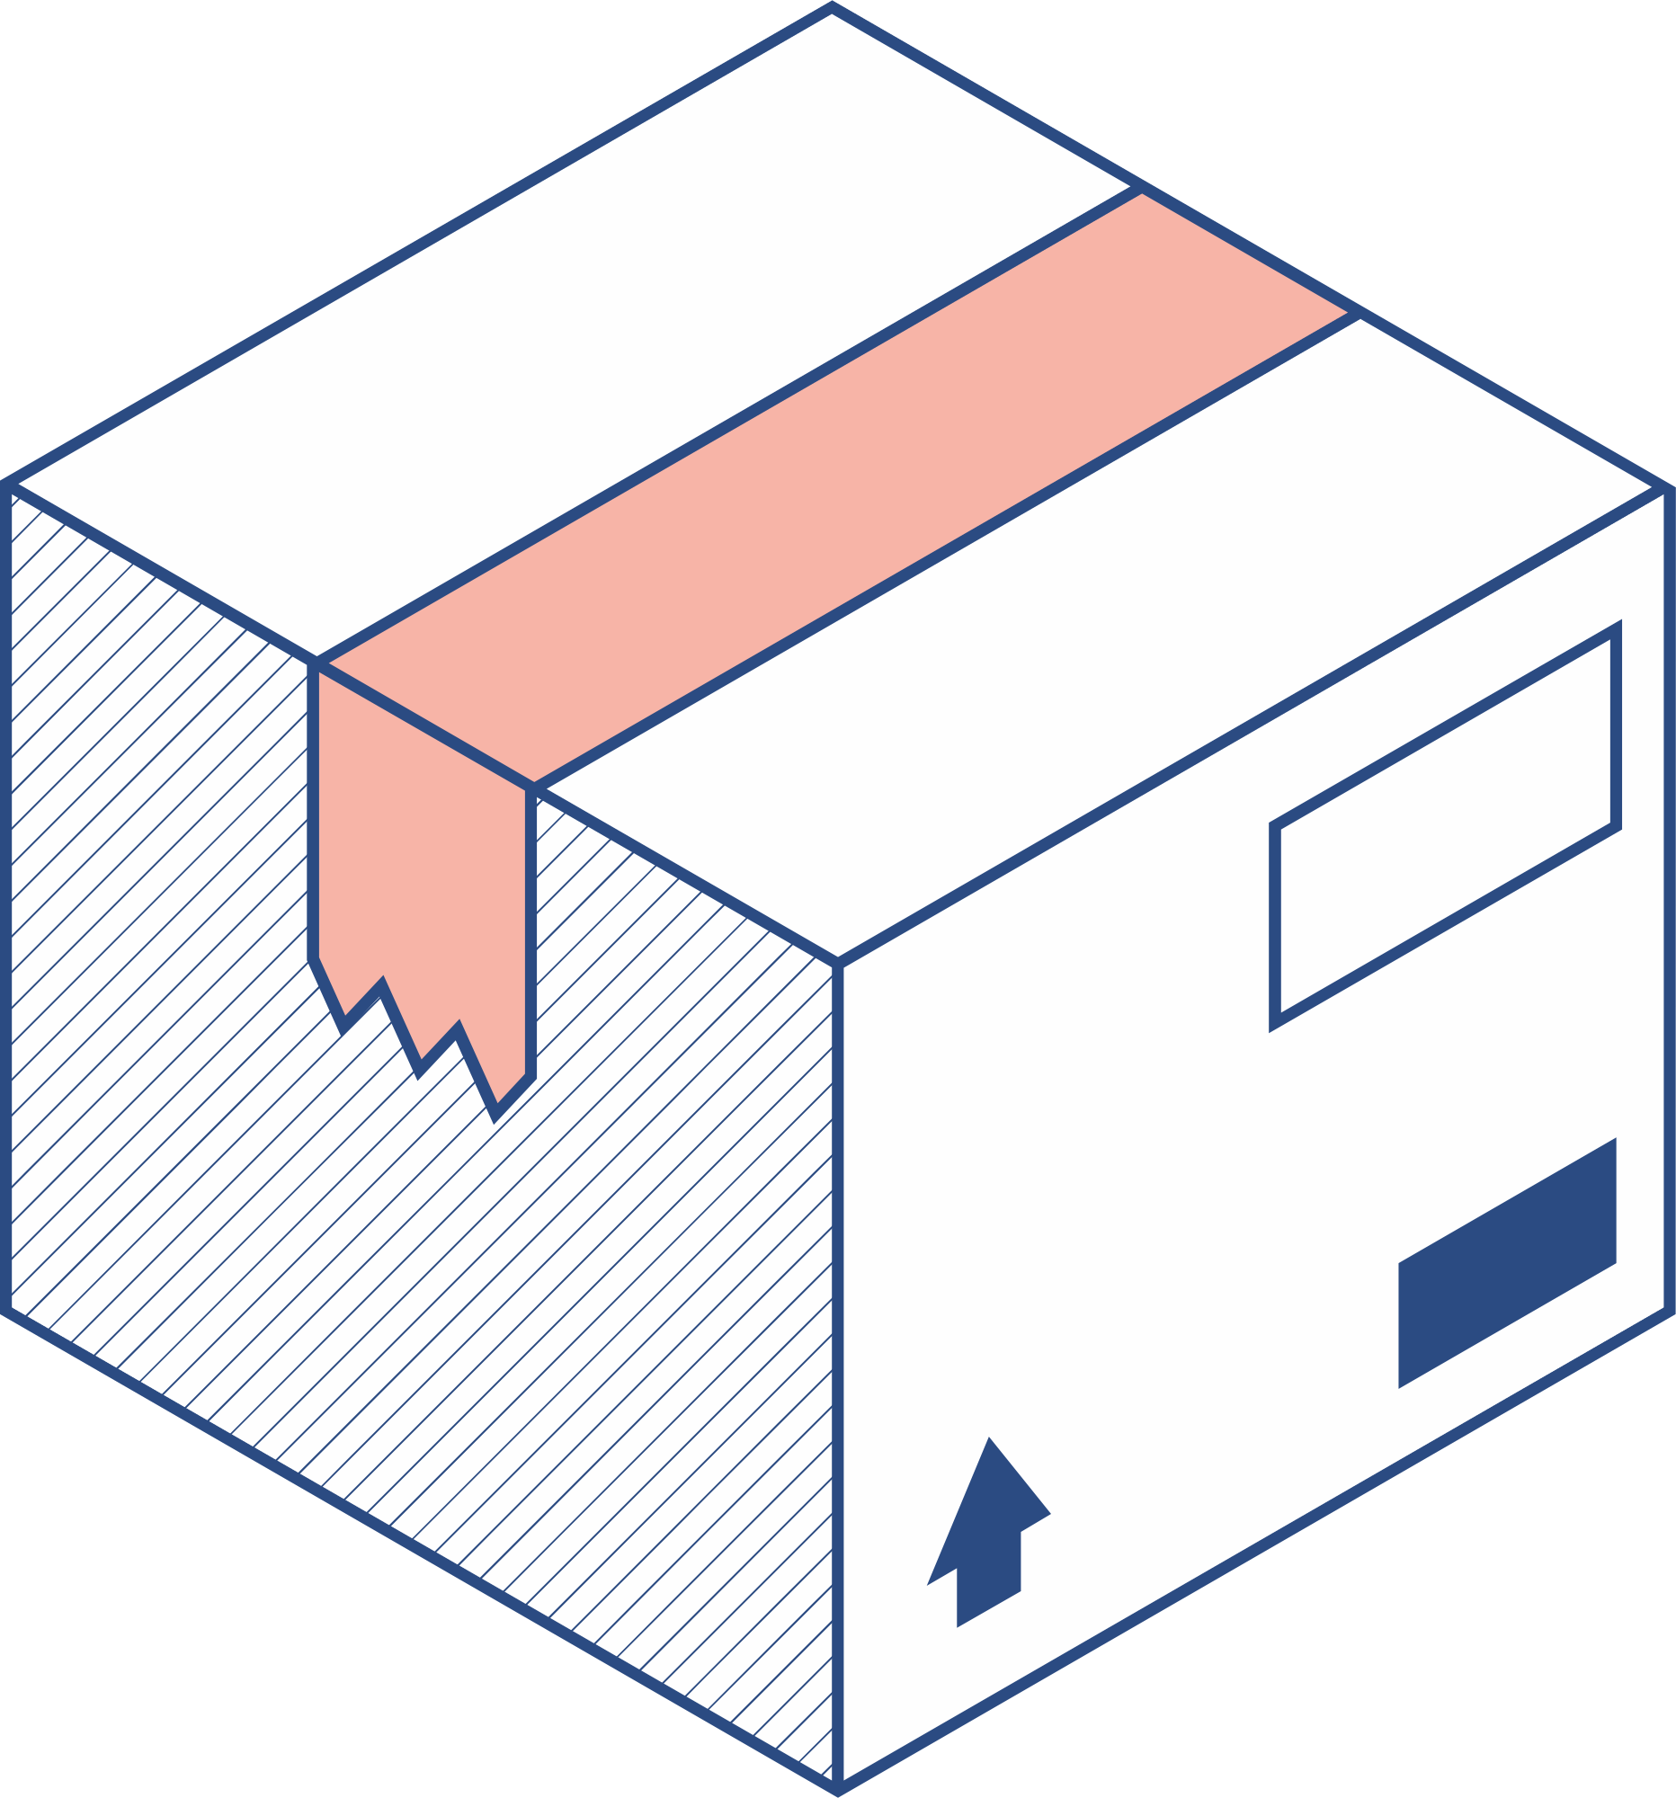

Facebook Marketplace | eBay
Overview: Facebook Marketplace is a peer-to-peer platform integrated into the Facebook app, allowing users to buy and sell items locally. Unlike traditional auction sites, it offers a more casual, classified-ad-style experience without bidding. Strengths: No Fees: Facebook Marketplace is free to use, making it attractive for casual sellers and buyers. Local Focus: It’s optimized for local transactions, making it easier to find buyers or sellers nearby. Weaknesses: Security Concerns: Since there’s no formal buyer or seller protection, users are responsible for managing transactions, which may increase the risk of scams. No Auctions: Unlike eBay, Facebook Marketplace doesn’t support auction-style listings, limiting its appeal for users who prefer that format. | eBay is one of the largest and oldest online auction platforms. It allows users to buy and sell a wide variety of goods, ranging from electronics to collectibles. eBay operates on a bidding system where users can place bids or opt for direct purchases through the "Buy It Now" option. Strengths: Wide Audience: With millions of active users, eBay has a massive reach, allowing sellers to connect with buyers globally. Weaknesses: Fees: eBay charges both listing and final value fees, which can cut into sellers’ profits. Complexity: Navigating the platform can be cumbersome for first-time users due to its extensive features.

Slide 8

Enhanced Security:
Auctionnest offers secure payment systems and robust fraud prevention measures, ensuring transactions are safe and reliable for both buyers and sellers
User Profile Verification:
Students have access to different channels where they can communicate and collaborate with teachers and fellow students.
Simplicity and User-Friendly Design:
Auctionnest is designed with ease of use in mind, offering a streamlined, intuitive interface that eliminates unnecessary complexity, making it accessible even to first-time users
Different From other’s
THREE KEY FEATURES

Slide 9




"With Auctionnest, technology transforms auctions into a safer, smarter, and more seamless experience for buyers and sellers alike."

Slide 10

Do you have any questions?
....

